Slide 1

Custom machine learning node for mask detection on Node-RED
Avi Alessandro
alessandro.avi@studenti.unitn.it
MAT: 214579

Slide 2
Goals of the project
Create a simple to use node for Node-RED
Perform image classification in the node
The prediction is used as a mask detector

Slide 3
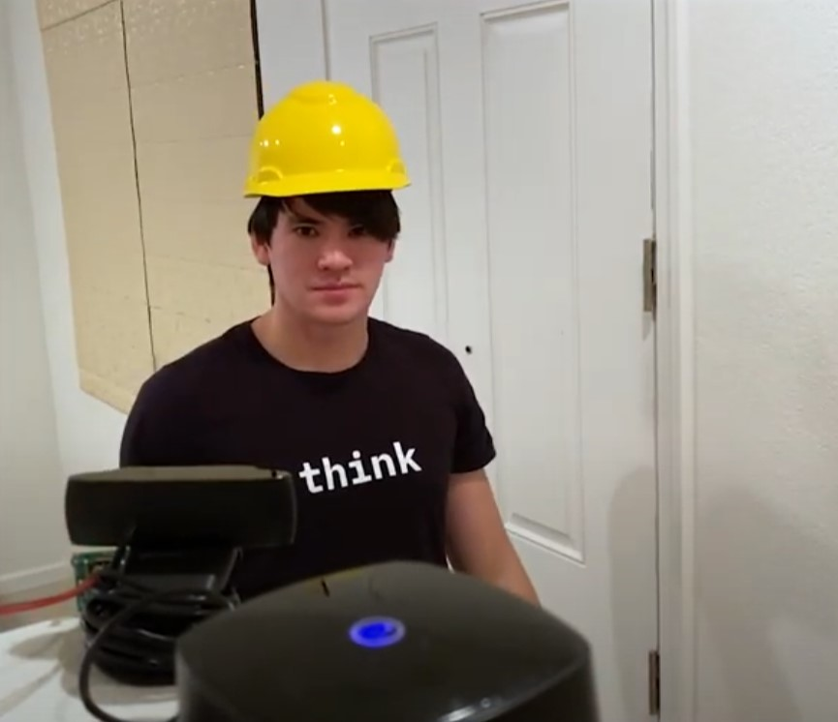

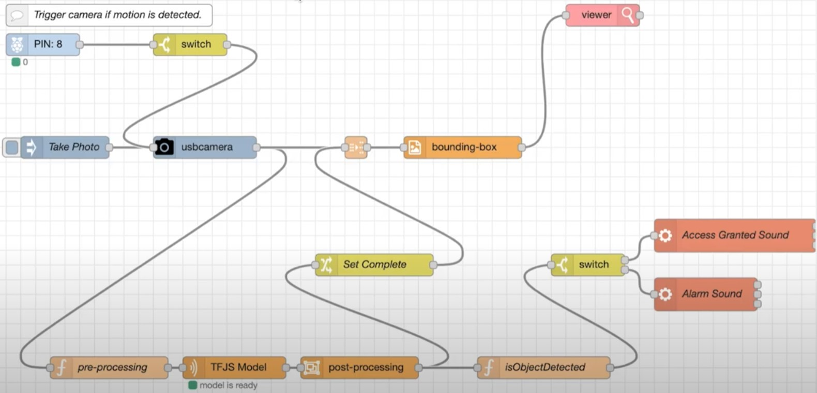
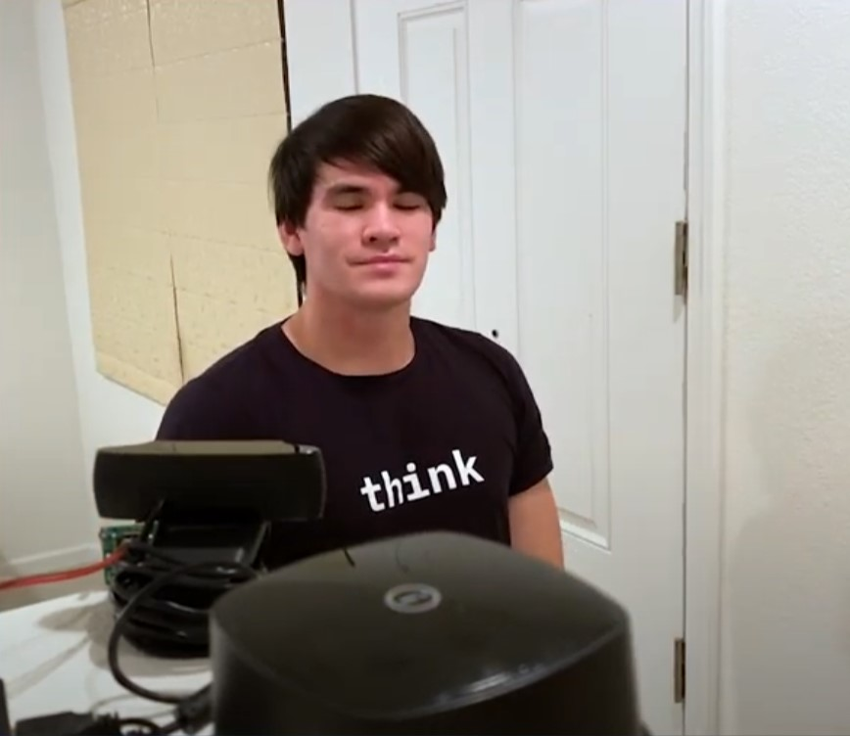


Related work
The idea is based on the project created by IBM
Deployed on raspberry
Object detection (hard hat)
Alarm if not detected

Slide 4






Set up of the project
In order to create a custom node for Node-RED that uses ML some installations ands tools are required
+
For the training of the model
Environment in which the node is deployed
Because installation of all packages on windows didn’t work
For the creation of the custom node

Slide 5
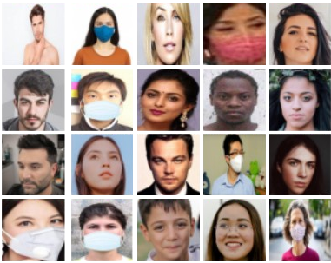
Creation of ML model - DATASET
Initially the dataset was composed of 60 images taken with my webcam
Solution: download bigger datasets from kaggle.com
Problems:
Images were all similar
Number of images was too low (even with augmentation)
Total images: 7993
Images labeled “with_mask”: 3945
Images labeled “witouth_mask”: 4048
No augmentation
All images are resized to 224x224 pixel (using roboflow.com)
The training performed was not robust and had poor performances

Slide 6
Creation of ML model - TRAINING
Type of NN: CNN
Performs binary classification (“with_mask” and “without_mask”)
Model based on MobileNet_V2 (enhanced performance on mobile devices)
Epochs: 5
Final accuracy: 99

Slide 7


Creation of node
Image = msg.payload
OUTPUT
The custom node behaviour can be divided in 3 functions:
Input pre-process
- Extract relevant info from prediction tensor
- Create JSON
- JSON file is created
- Store inside JSON: label predicted, score, available labels
- Store JSON inside msg.payload
Perform prediction
OUT PROCESS
Output process
- Transform msg.payload into tensor
- Reshape tensor to 224x224
- Cast tensor to float
INPUT
PRE PROCESS
- Call the TF function model.predict and obtain a tensor with the prediction
PREDICTION

Slide 8
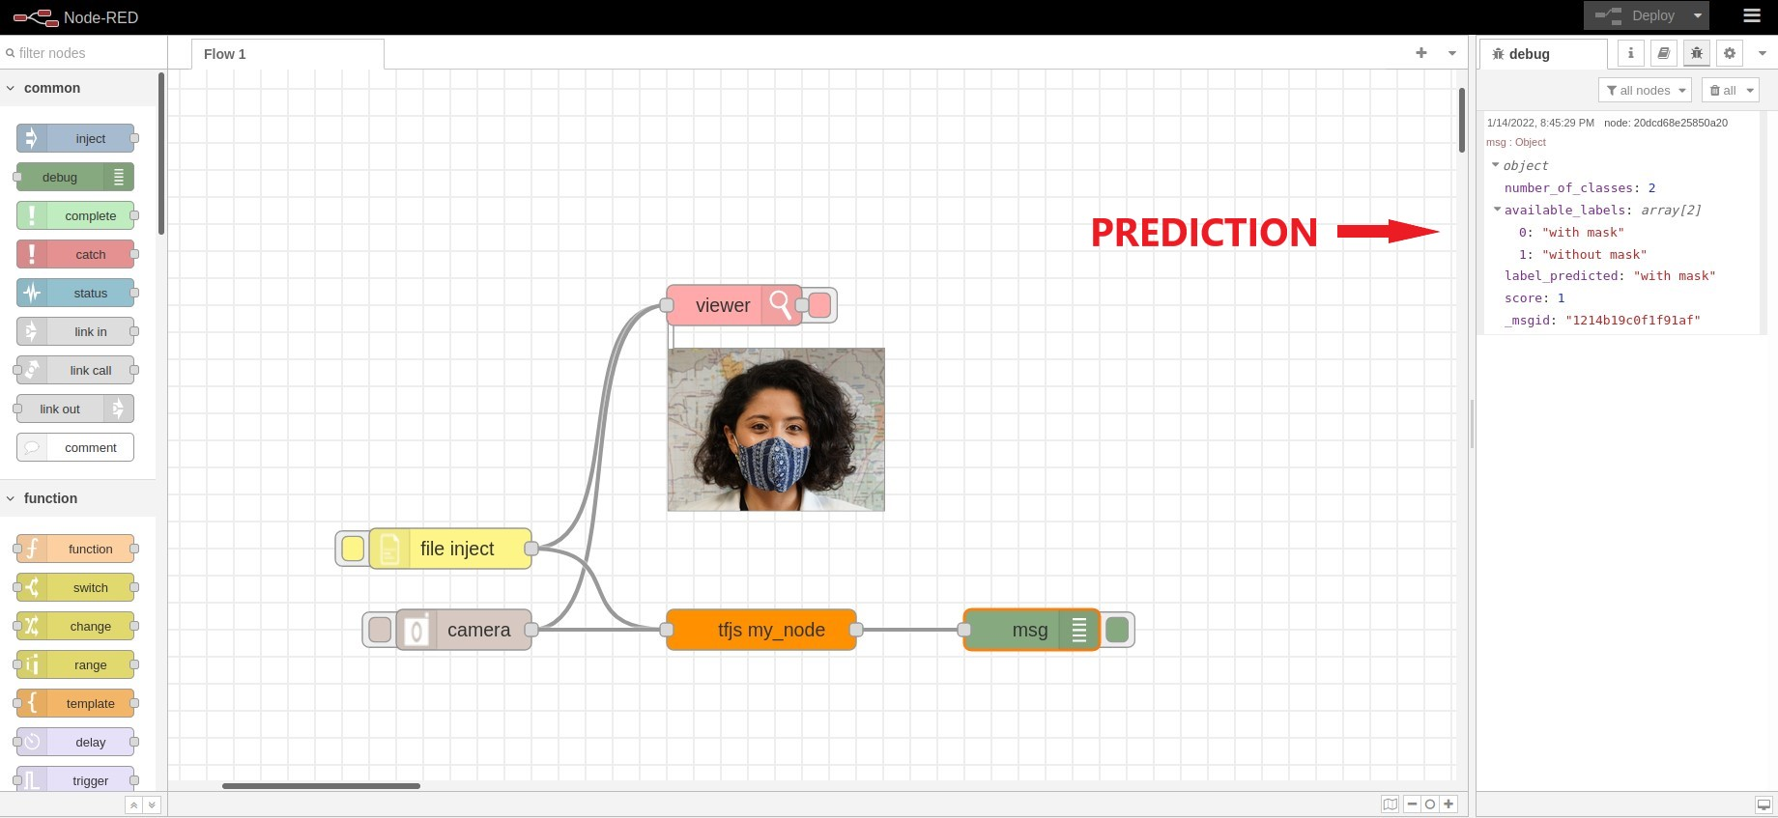
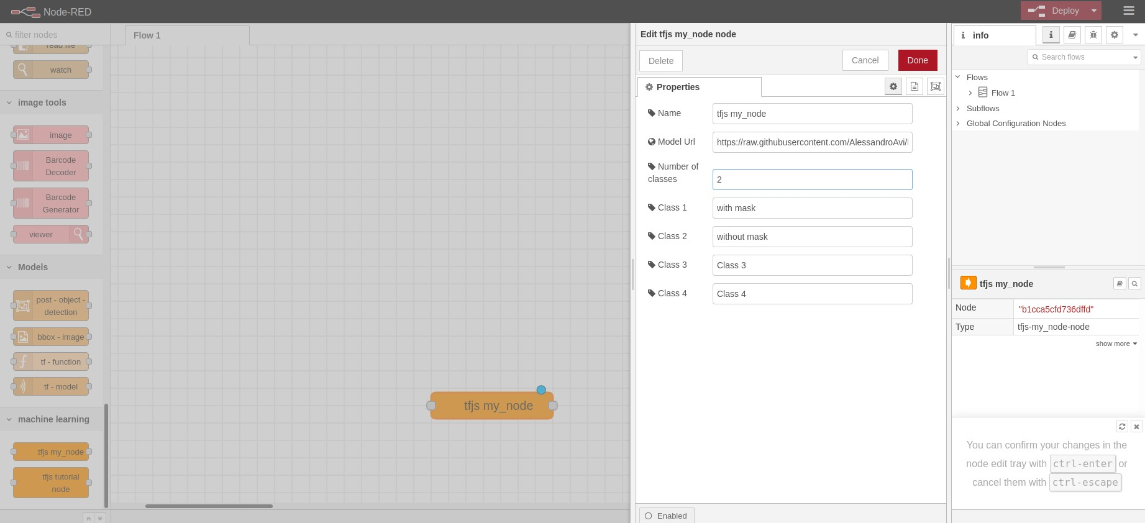
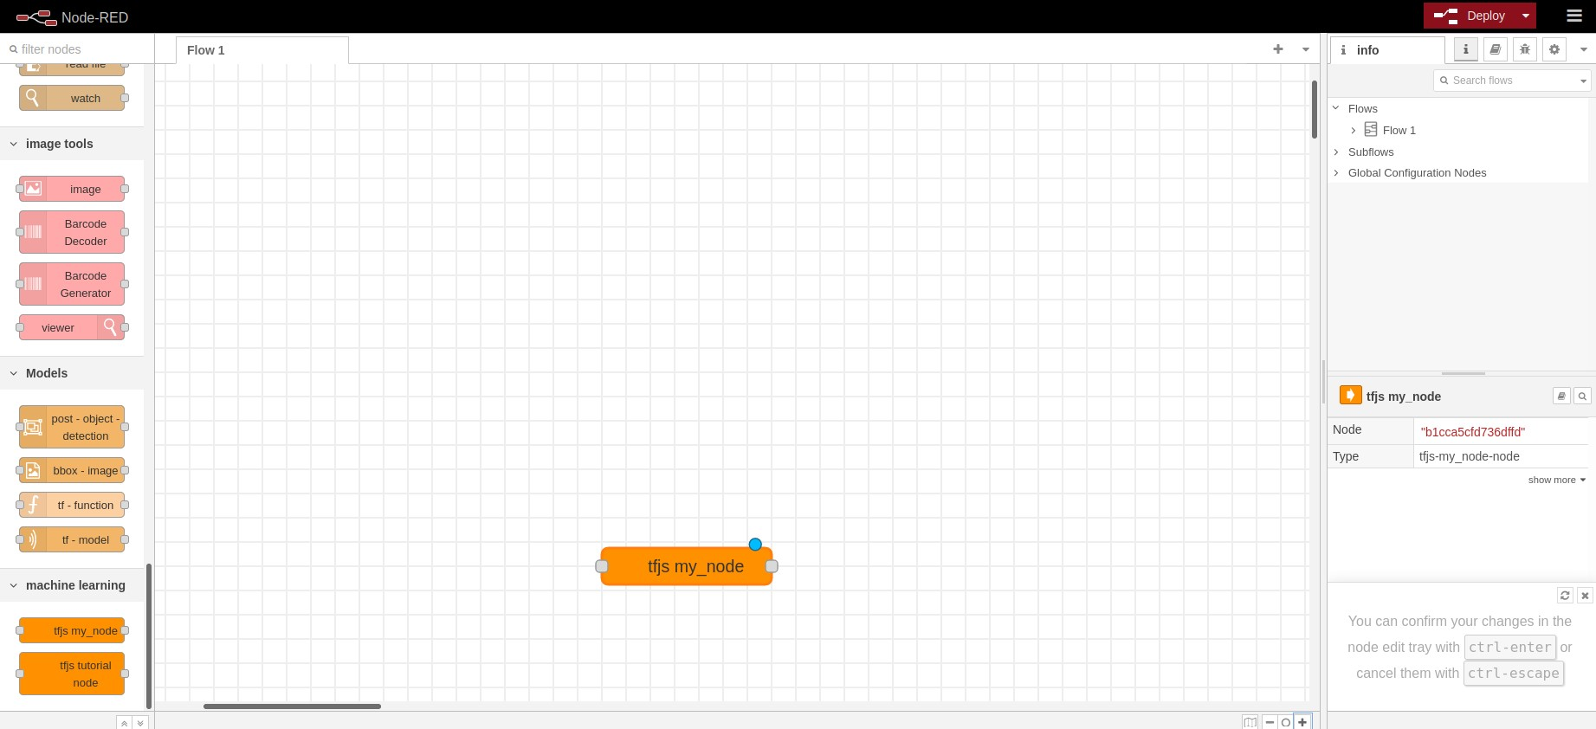
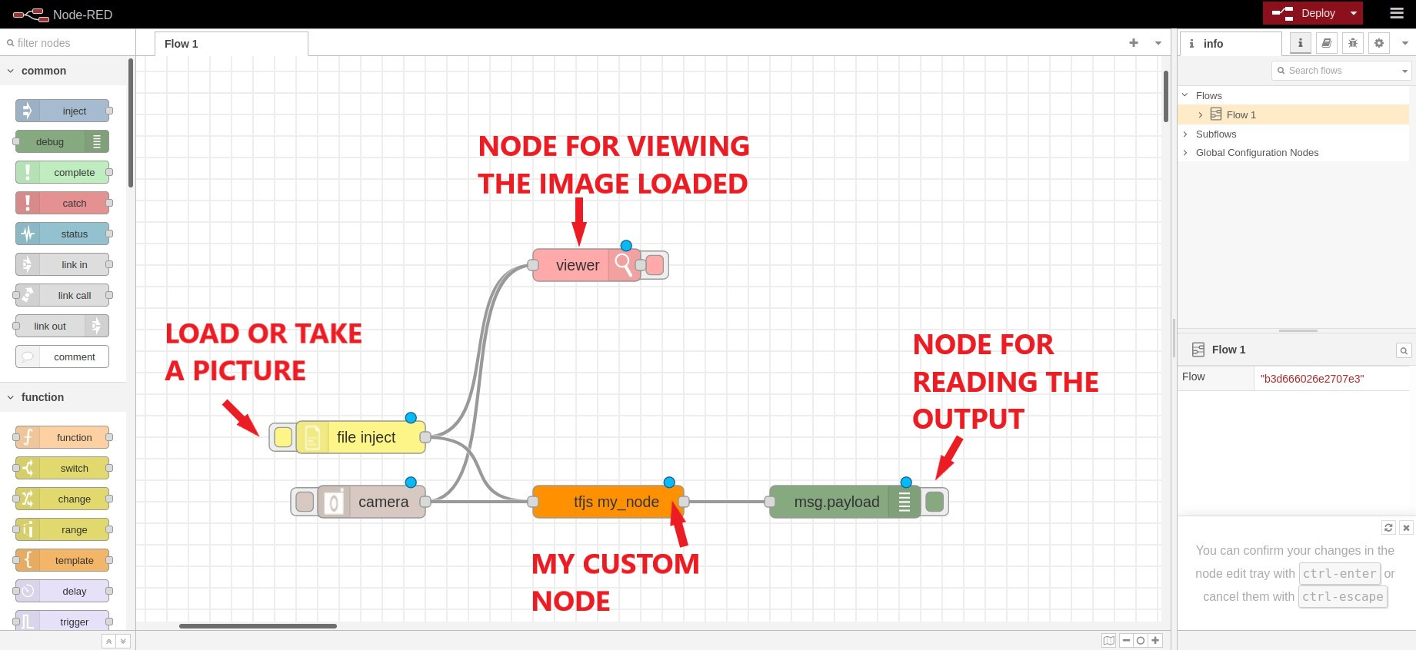
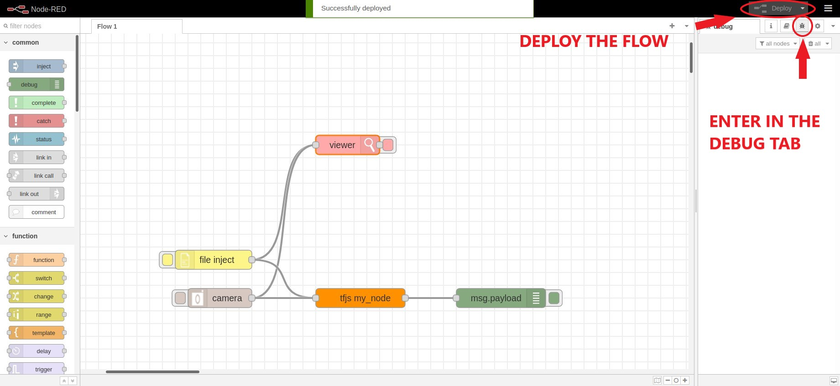
Demo in Node-RED
The actions to follow for using the node are:
Insert the node in the flow
Insert the correct node parameters
Connect the external nodes
Deploy the node
Load a picture/take a picture

Slide 9
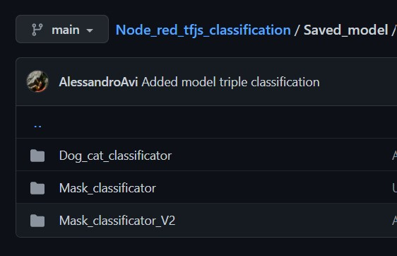
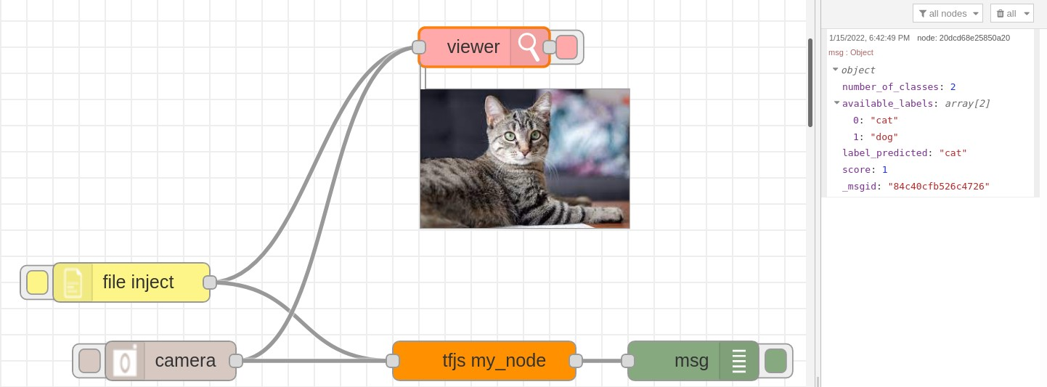
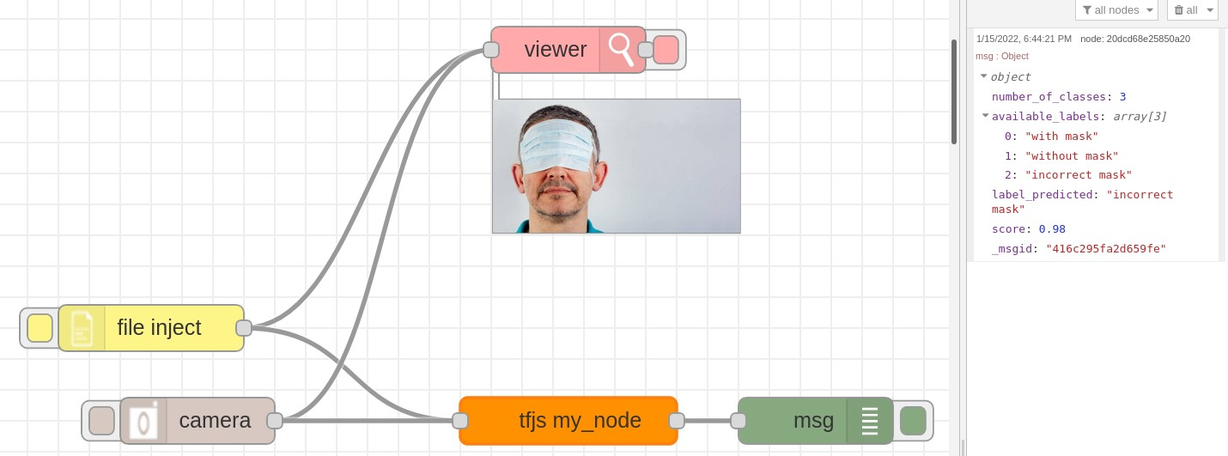
Flexibility of the node
Since the TF function LoadGraphModel requires the specification of just a link for loading the model, it’s possible to load any type of classification model from the web.
I loaded other classification model on my GitHub repository
Test 1: classification of dogs and cats
Test 2: classification of mask images (3 classes)
“with_mask”, “without_mask”, “incorrect_mask”

Slide 10
Conclusions
Future work
Creation of custom node for prediction on Node-RED is successful
It’s possible to load different classifications model just using a link
Apply the same system on a raspberry
Apply different types of ML model on other data

Slide 11
THANK YOU
FOR YOUR ATTENTION

Slide 12
Custom machine learning node for mask detection on Node-RED
Avi Alessandro
alessandro.avi@studenti.unitn.it
MAT: 214579

